Slide 1
Get the Math and Get the Points!!

Slide 2
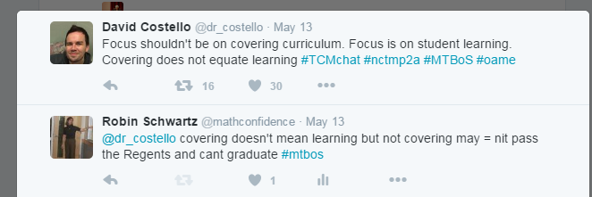

Slide 3
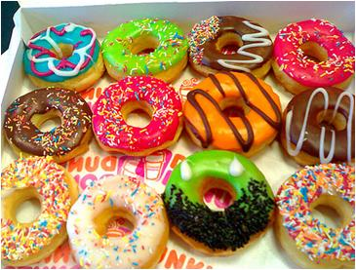
Mixed Practice

Slide 4
Questions
How do you know?
Are you sure?
Why?
Compare contrast
Multiple Choice
Easy? Medium? Hard?
Modify the Question
Step by Step
What do you notice?

Slide 5
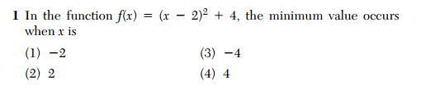
Notice x

Slide 6
totally doable
#3 look at blog

Slide 7
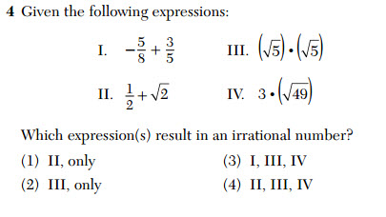
TI-84 Which looks irrational?

Slide 8
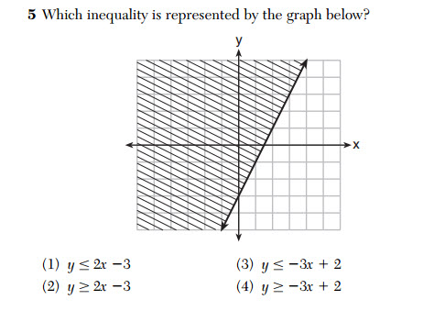
Equation of a line
Use Y=

Slide 9
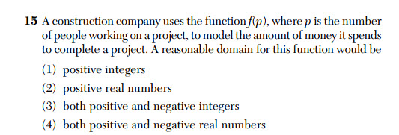

Slide 10
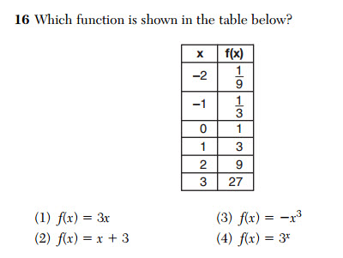

Slide 11
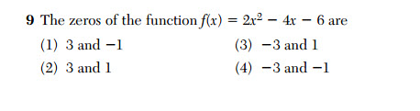

Slide 12


Slide 13
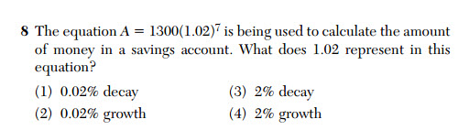

Slide 14
Long answers
25, 26, 28, 32

Slide 15
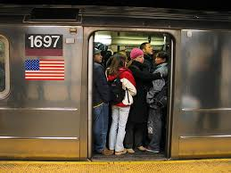
Grading in Public

Slide 16
Good Wrong Answers
Why for Sp Ed?
Increases
Metacognition
Work Ethic
MC can be used in constructive way

Slide 17







Content Exposure

Slide 18
Matt Larson PPT
Challenging Curriculum
Equity
Parents
Effective Instruction

Slide 19


